Slide 1

Report on the Activities Involved and Observations Made During the Induction Programme
Course Title: Introduction to Engineering
Course Code: BCSE103N
Name of the Student: KALYAN CHAKRAVARTHY
Registration Number: 21BAI1759
Programme: Bachelor of Technology in Engineering (with Specialization in Artificial Intelligence and Machine Learning)
School: School of Computer Science and Engineering(Scope)

Slide 2
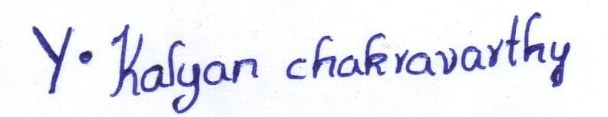
Declaration I, Mr. / Ms. _KALYAN CHAKRAVARTHY (21BAI1759), hereby declare that the report submitted by me, as a partial fulfilment of the course on ‘Introduction to Engineering (BCSE103N)’ registered during Fall Semester 2021 – 22, is a record of the activities involved and the observations made by me during the induction programme during September 2021 – October 2021. To the best of my knowledge, this document has been prepared by me keeping in mind the professional ethics and has not been copied either in part or in full. Date:27-12-2021 Signature of the Student Place: ANDHRA PRADESH(PRAKASAM)

Slide 3
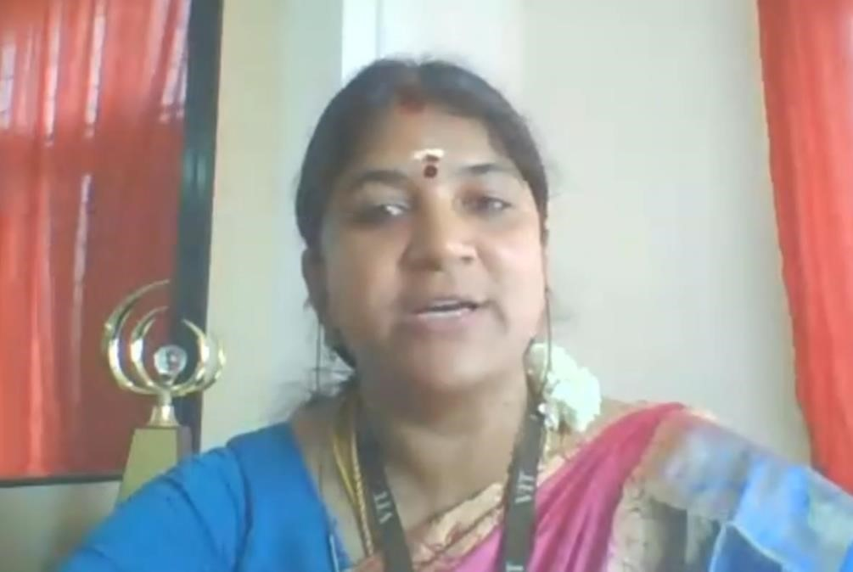
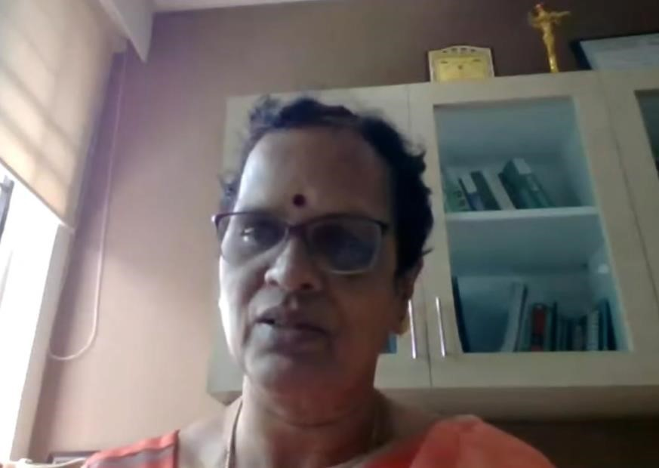
1) DETAILS ON ACTIVITIES INVOLVED DURING THE INDUCTION
Our induction cermony was scheduled on 6th of September 2021.
Welcome address was delivered by Dr.Vijayalakshmi mam (Asst.prof.school of social science).She welcomed the distinguished guests and gave a brief introduction about them. She congratulated students for joining this prestigious institution. At last she welcomed and invited Dr. V. S. Kanchana Bhaaskaran(Pro Vice Chancellor) VIT Chennai to deliver her felicitation address.
Dr. V. S. Kanchana Bhaaskaran our Pro Vice Chancellor greeted the guests and she congratulated us on recently getting significant achievement of VIT for getting the NAAC A++ Grade accreditation with 3.66 CGPA Points. She introduced us about the multidisciplinary ambience, learning opportunities and exposure we would be getting at VIT. She assured us that our strive for excellence would be definitely achieved here at University. She showcased the major strength, vision and mission of VIT. She briefed about the excellent infrastructure and well qualified faculties , advantage of its proximity to Industries and collaboration with leading institutes across the globe. She advised students to make best use of this opportunity to realize our ambition, so that our dream come true. At last she quoted Swami Vivekanand words as “You are the creator of your own destiny” .
Next Dr. Rambabu Kodali, Vice Chancellor, VIT briefed us about the journey of our college and its first milestone from Vellore Engineering College to Vellore Deemed to be University in 2001. He stated us about the old days at VIT, as it was founded by our Chancellor Dr. G Vishwanathan in 1984, the college was started with 15 faculty members, 180 students and at that time it offered 3 programme, it won 8 out of 9 university medals in its very beginning.

Slide 4

In the continuous pursuit of academic excellence and creating a student-friendly learning environment, VIT introduced the Fully Flexible Credit System
It is a beneficial system that students with all learning needs, whether someone wishes to complete subjects early or pursue subjects of the other branches for acquiring a Minor/Honours degree. In addition, this system ensures offerings of subjects from all disciplines, encouraging students to pursue multiple interests and develop holistically.

Slide 5
Day 2:
First session of day two is the Indian Heritage & culture by Dr .Vijayalakshmi. That was a very informative session .She explained about history of Indian culture and religion and etc
And day 2 is full of EPT exam (English proficiency test).
Then Dr.Pradeep Kumar instructions about EPT and explained about time slots for each department and about the platform, am online leaning management system (LMS), Moodle ,on which most of VIT”s tests are conducted.
The EPT was done to test the English skills of students. The students were assured to be given help in English if they weren’t good enough. The EPT was conducted in two days. One of which was a mock test and the other day included the actual examination.
If the EPT mock test was not a success then slot wise EPT will be scheduled for students.

Slide 6
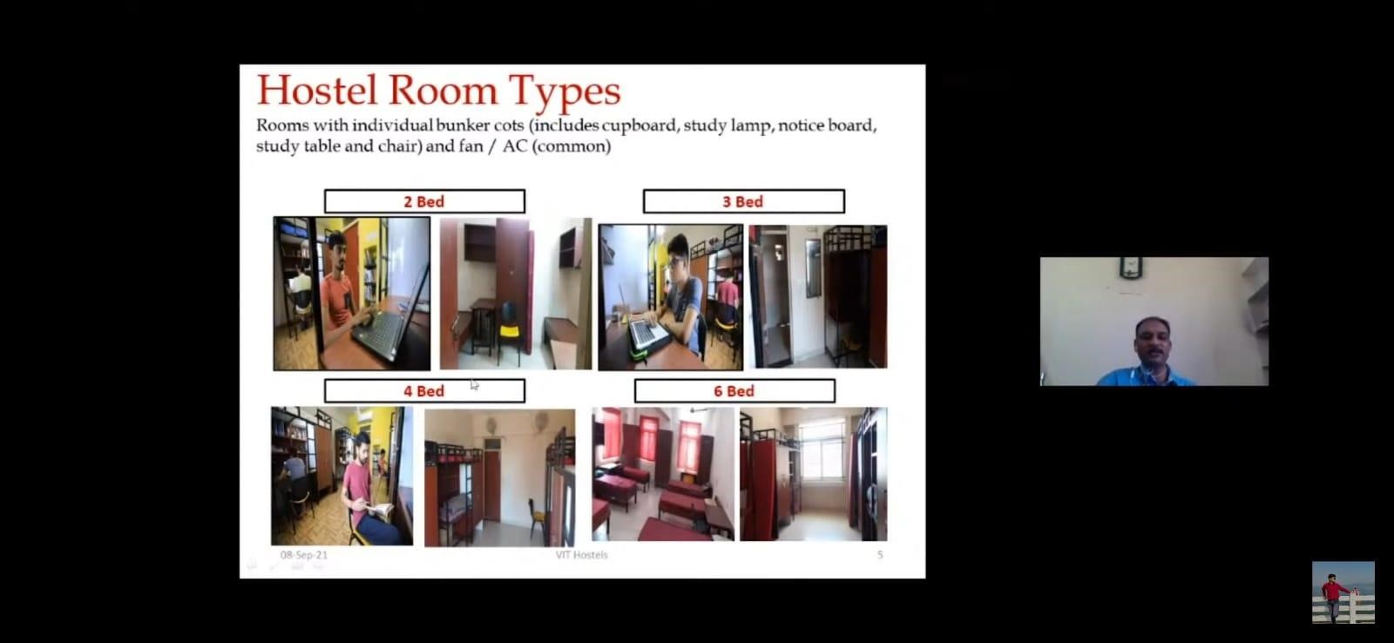
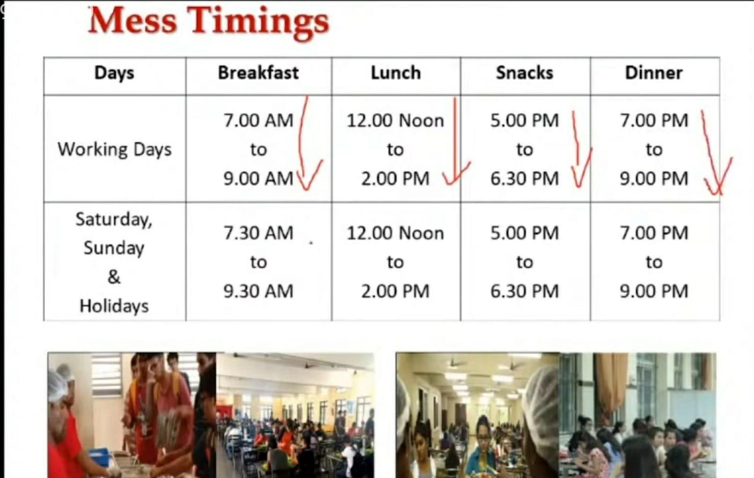
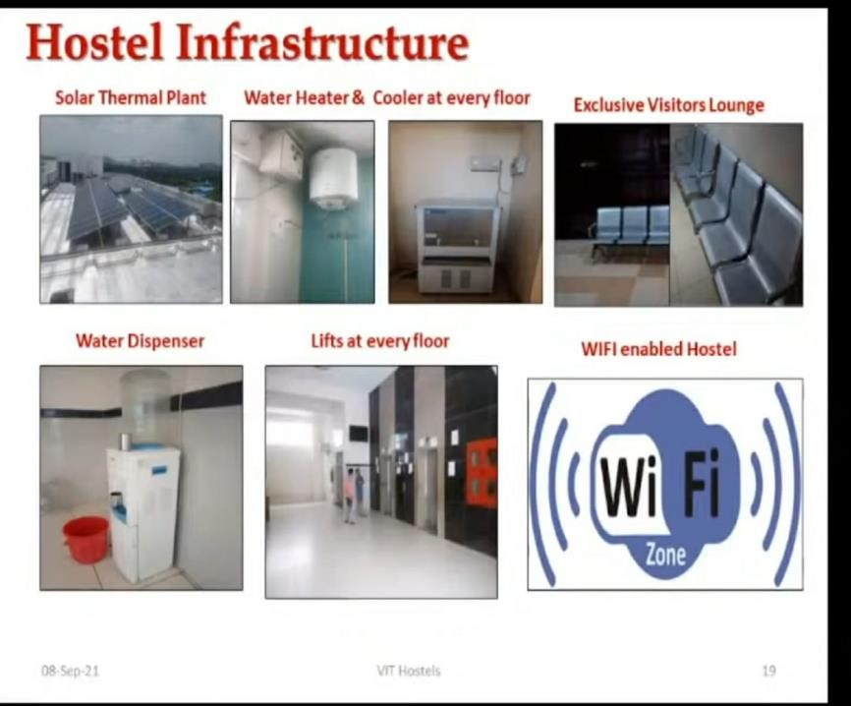
The First session of day 3 started at 9 am with the introduction of VTOP by Dr. Pradeep Kumar T.S, Deputy Director and Dr. Suganya, Assistance Director. They clearly explained about the website which has been created by VIT.
The second session is hostels procedure & facilities at VIT Chennai by Dr.V.Pattabiraman. He clearly explained about hostels very well and it was very informative session given by him about hostels.
HIGHLIGHTS
2,3 AND 4 BEDDED AC/NON AC ROOMS
OPTION AC FACILITY
24/7 HEALTH CARE FACILITIES AVAILABLE
ENTERTAINMENT HALLS WITH MULTI CHANNEL TV FACILITY
OPEN AIR MOVIE SCREENING FACILTY(WEEKLY )
24/7 CCTV INVIGILANCE
RO WATER IN ALL FLOORS FOR DRINKING
SOLAR HOT WATER FOR BATHING PURPOSES
REGULATED HOUSE-KEEPING CARE
GREEN AMBIANCE

Slide 7
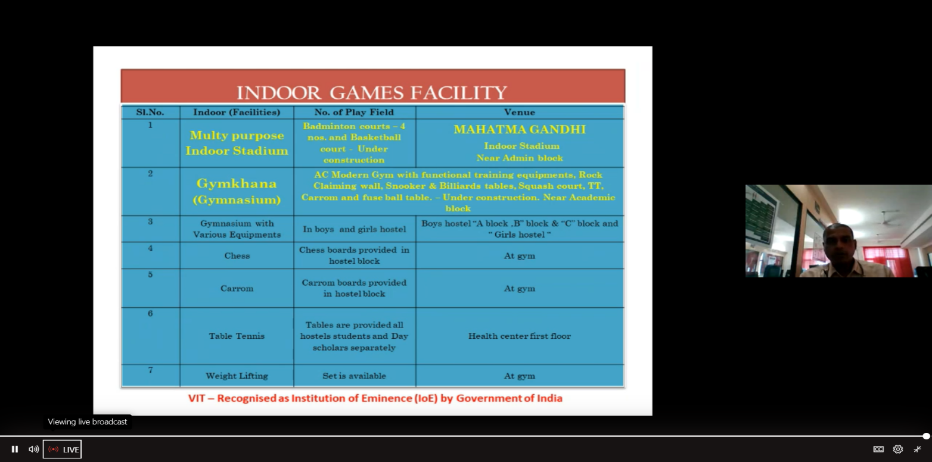
Yoga for healthy life by Mrs.Padmini jog.
Sports:
Sports at vit Chennai by Lt.P.M.Balamurali
Sports is very essential for every human life which keep them fit and fine and physical strength. It has great importance in each stage of life. It also improves the personality of peoples.
To give all the freshers a red carpet welcome. Dr. Geeta (Associate Dean and professor ,SCOPE, VIT Cnennai )was invited with the welcome address. She told us about the history of the school of computer engineering here at VIT’s Chennai campus and explained how the program would help us develop our skills and create a bright future with a stable career.

Slide 8
2. Learning during the general induction programme
EXAMINATION AND EVALUATION PROCESS
Dr. V. Sugumaran professor and Deputy controller of examinations addressed us about the examination and valuation process.
COE Announcements:
FAT schedule and other COE announcements are communicated to students through their official VIT mail.
Students are strongly recommended to check their VIT mail regularly.
Do’s and Don’ts during FAT exams will be communicated to the students, students are required to read the complete document.
Exam Schedule
Exams will be conducted based on slots (A to G).
CAT will be conducted by Academics office and FAT will be conducted by CoE office.
About Eligibility for examination
Grading:
Absolute grading: if the class strength is less than or equal to 10 students.
Relative grading: if class strength more than 10 students.
CUMULATIVE GRADE POINT AVERAGE (CGPA): CGPA indicates the overall performance of a student from the time he/she joined the University to a specific semester.

Slide 9
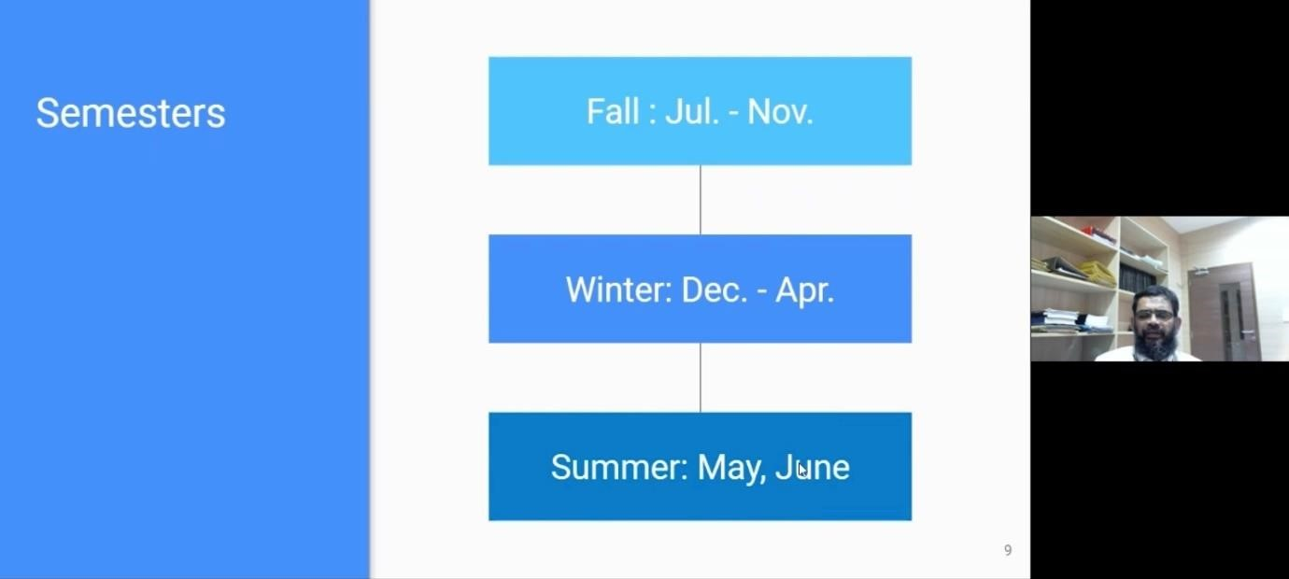
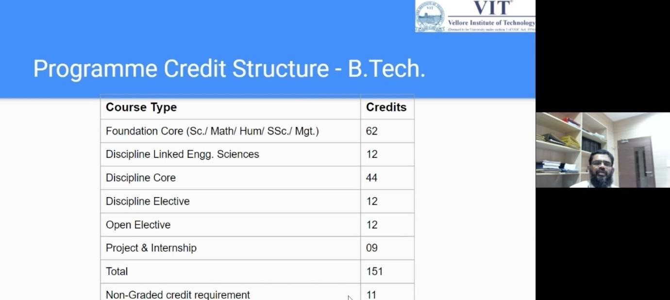
3. Learning during the discipline specific programme
ACADEMICS AT VIT Chennai :
The academics at VIT Chennai was discussed by Prof. A. Nayeemulla Khan(Dean Academics, VIT Chennai).Mr. Nayeemulla began by portraying the Academic calendar for the Fall 2021-22 semester. He had informed students about the CAT- I examination which is the first exam for freshers yet to commence from the 18th of October 2021.
Afterwards a sample programme credit structure of B.tech computer science course was discussed. Next, the different course types were discussed with courses being either theory only, lab only, theory+lab embedded or theory +tutorial. later, the credit system was explained. Students need a minimum of 16 credits each semester and can go all the way upto 27 credits. However if a student has a gpa of less than 4.0 he'll be advised to take 20 credits per semester.
Attendance at VIT Chennai is compulsory and student are allowed to attend the final assessment if they have 75% of attendance in the semester. 100% attendance is recommended and will be rewarded.

Slide 10
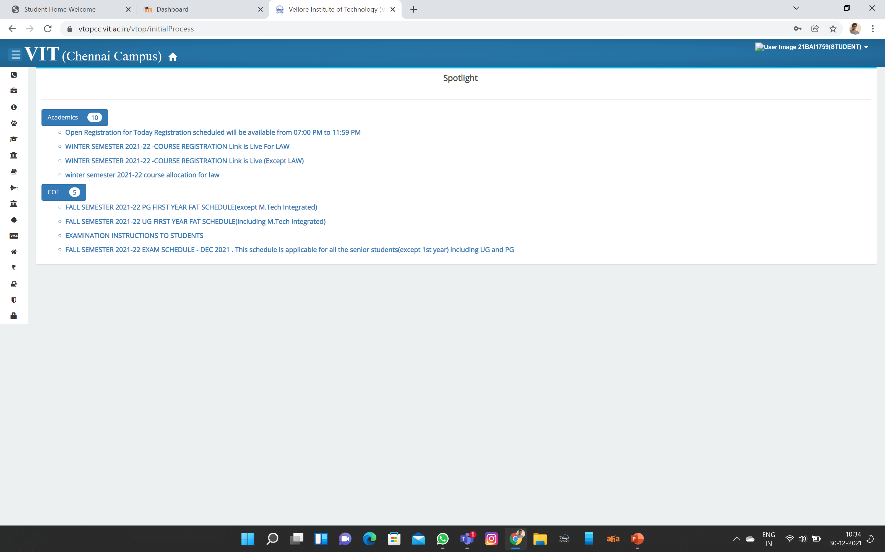
4)Learning from the Institutional Website
VTOP CONTAINS ALL DETAILS OF STUDENT
IN VTOP CLASS TIMETABLE,CLASS ATTENDENCE,EXAM MARKS,EXAM SHEDULE WILL BE PRESENT.
ALL FEE RECIPTS CAN BE DOWNLOAD FROM VTOP
WE CAN SUBMIT OUR WOKS IN VTOP
IN VTOP WE CAN SEE OUR LOGIN CREDENTIALS etc..

Slide 11
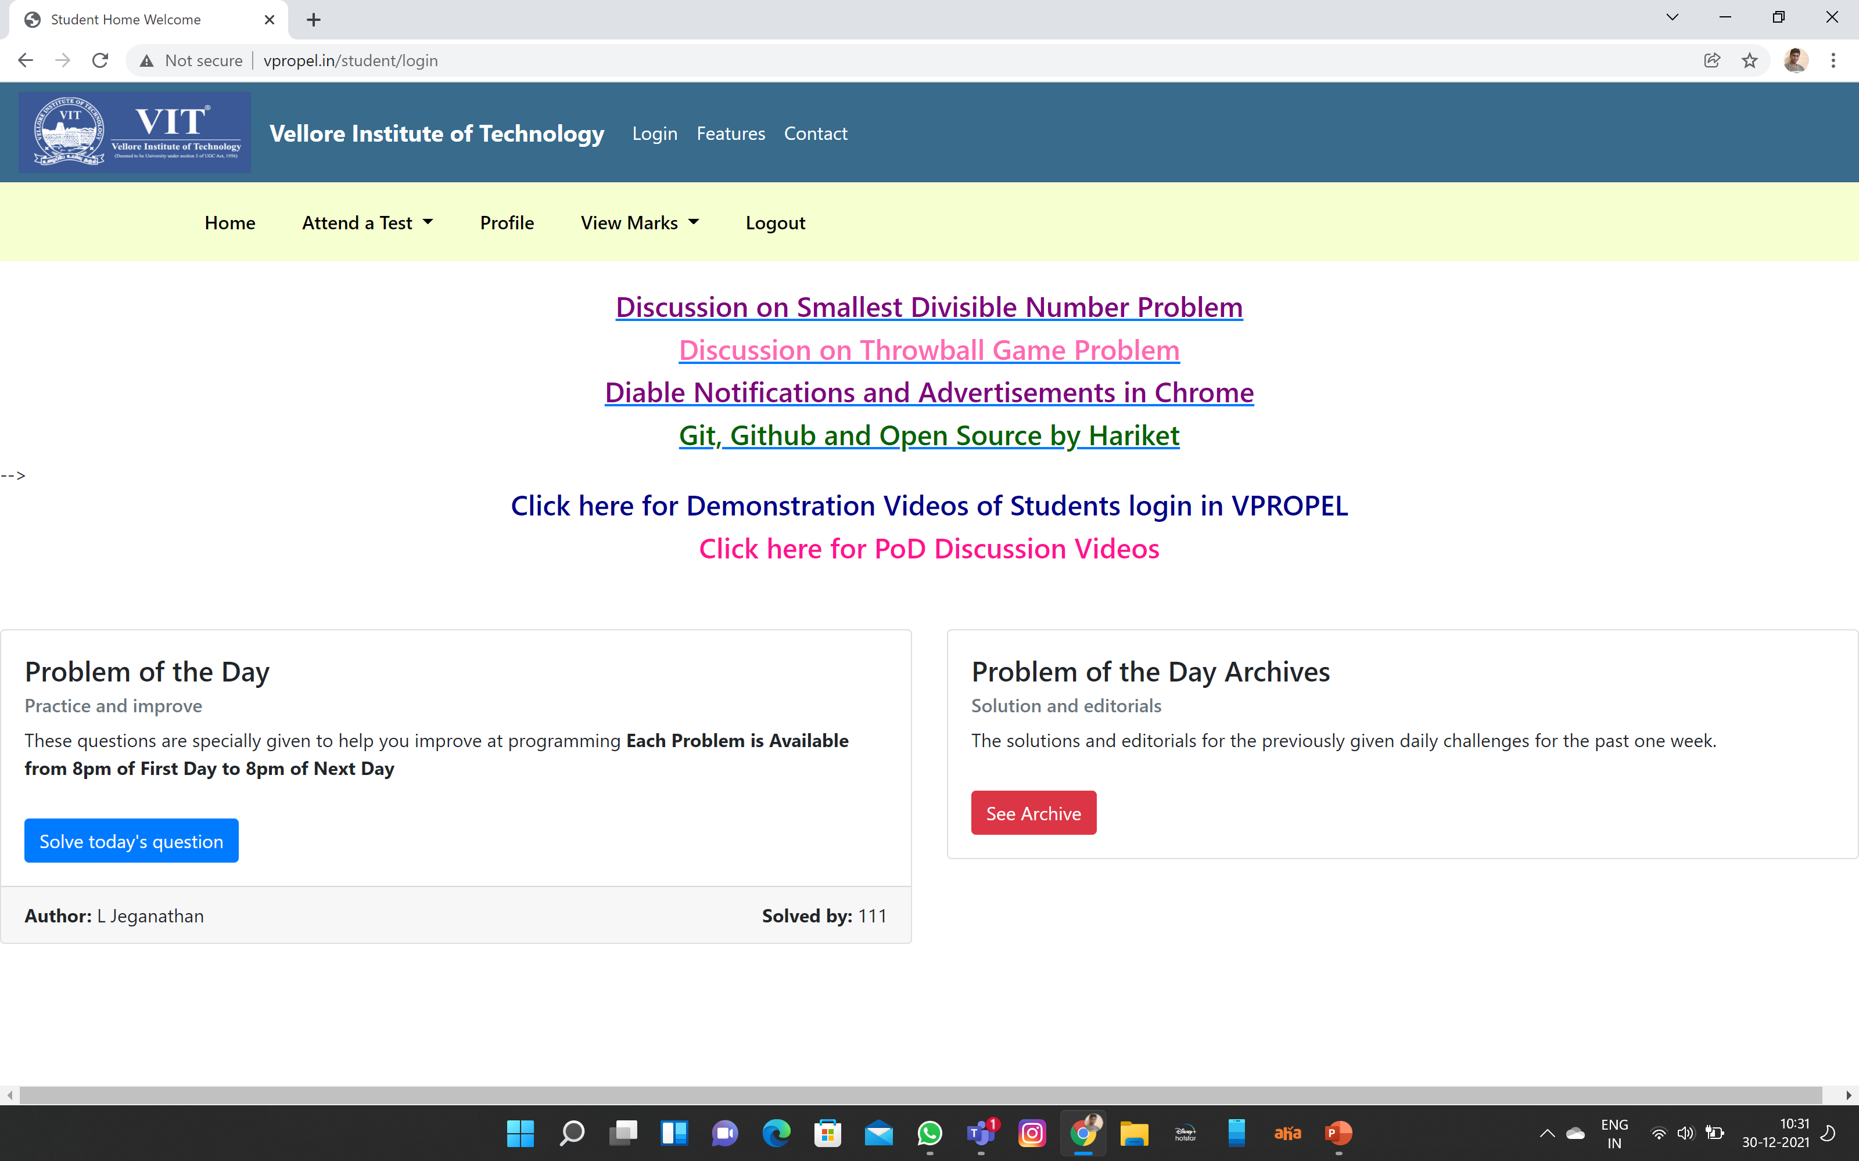
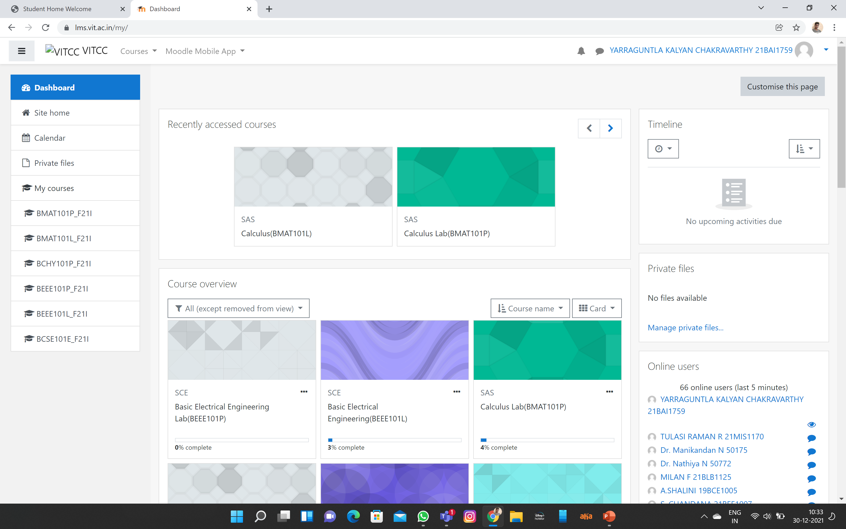
IN VPROPYL WE CAN WRITE COMPUTER BASRD EXAMS LIKE PYTHON ,C,C+.
EVERY DAY “PROBLEM OF THE DAY” WILL BE DISPLAYED IN VPROPYLWE CAN SOLVE IT .
IN MOODLE WE CAN UPLOAD OUR ASSIGNMENTS .
WE CAN WRITE OUR EXAMS SUCH AS “BSTS” AND “PYTHON”

Slide 12
5)Learnings from Do it yourself activities
My Project:
The project I have chosen to do is a simple program which plays the game rock paper scissors.
It can be used to play the above mentioned game for fun.
The Process Involved:
The random module is imported for making random choices
The player's choice is taken in form of R for Rock , P for Paper and S for Scissors.
The pc choice is generated randomly by using the random module
The winner is decided based on the rules P (paper) over R (rock) , R (rock)over S (scissors), S (scissors) over P (paper) using if conditions.
The number of wins is stored and displayed as an output.

Slide 13
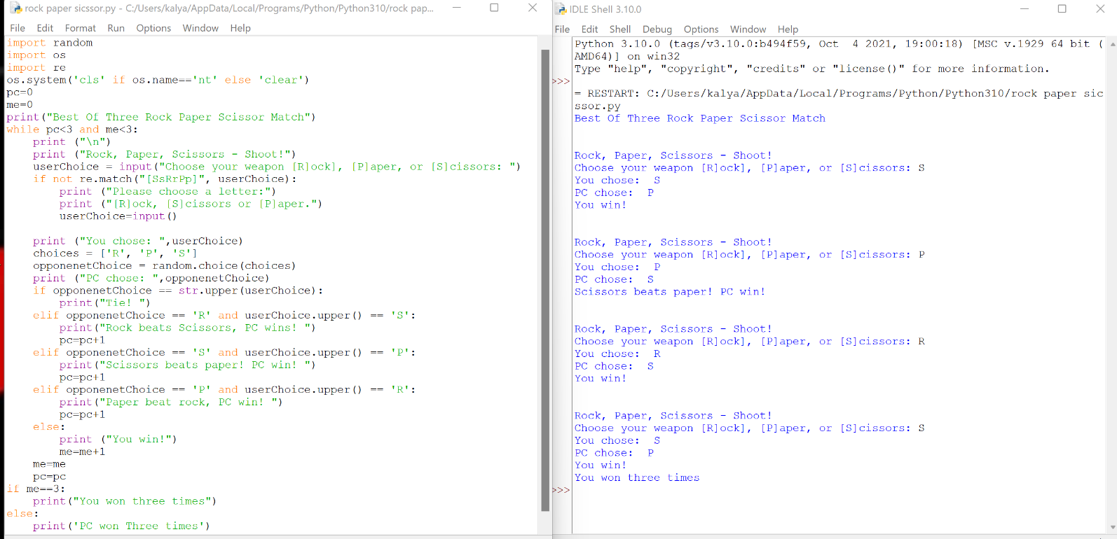

Slide 14
6)ANY OTHER GENERAL OBSERVATIONS
The teachers who taught us were good.Their presentation, explanation and content were interesting.
I learn many new things during the cultural event and yoga event.Overall the induction program was amazing.
VIT has good support system with websites likes “VTOP,VPROPYL,MOODLE”.
FFCS will be very useful for students .if they use it correctly.

Slide 15
7)Initial learnings and opportunities for self-development
We have to work continuously on different things to improve our knowledge and skills.
VIT is providing many opportunities for students like meetings with faculties from abroad ,group projects with students to increase their confidence .

Slide 16
thank you

